Slide 1
Elective Module 2 – Cloud Computing
(17 hours)
Notes:
Title - The learning outcome
Subtitle - Duration

Slide 2
In this section, we will discuss:
IBM Cloud DevOps Toolchain & Services
Notes:
Mention the parent topics one by one. This particular learning outcome has 4 parent topics.

Slide 3
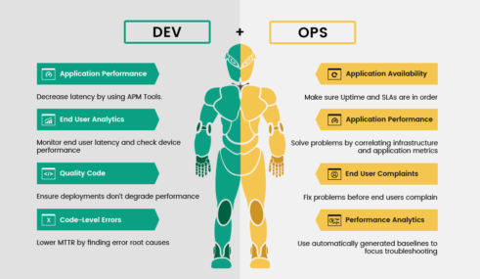
IBM Cloud DevOps Toolchain & Services
What is IBM Cloud DevOps
?
DevOps is the combination of cultural philosophies, practices, and tools that increases an organization’s ability to deliver applications and services at high velocity: evolving and improving products at a faster pace than organizations using traditional software development and infrastructure management processes. This speed enables organizations to better serve their customers and compete more effectively in the market.
Image Source: https://assets.botmetric.com/wp-content/uploads/2017/11/Ingraphics-devops-to-agile-491x285.png
Notes:
Left (White Color space):
Title - Parent Topic
Subtitle - Subtopic 1
Body Text - Description in bullets
Right (Grey Color Space):
Body Text - Relevant image (with source)/code snippet
Put reference links in Speaker Notes
Reference:
https://www.tutorialspoint.com/internet_technologies/internet_overview.htm/

Slide 4
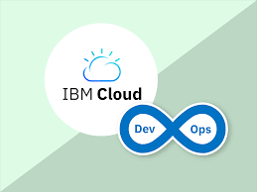
IBM Cloud DevOps Toolchain & Services
What is IBM Cloud DevOps
?
An enterprise application Developer can start building and deploying cloud-native applications in minutes. They can use a full set of services to build cognitive, IoT, blockchain, mobile, and data-intensive applications.
Image Source: https://encrypted-tbn0.gstatic.com/images?q=tbn:ANd9GcTup2rQjkFS1iMi_XTRewYYRQVTDuEXY8kRaQ&usqp=CAU
Notes:
Left (White Color space):
Title - Parent Topic
Subtitle - Subtopic 1
Body Text - Description in bullets
Right (Grey Color Space):
Body Text - Relevant image (with source)/code snippet
Put reference links in Speaker Notes
Reference:
https://www.tutorialspoint.com/internet_technologies/internet_overview.htm/

Slide 5
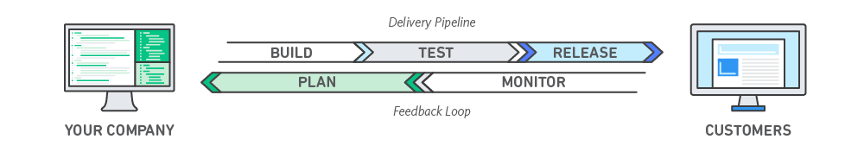
IBM Cloud DevOps Toolchain & Services
How DevOps Works
Under a DevOps model, development and operations teams are no longer “siloed.” Sometimes, these two teams are merged into a single team where the engineers work across the entire application lifecycle, from development and test to deployment to operations, and develop a range of skills not limited to a single function.
Image Source: https://d1.awsstatic.com/product-marketing/DevOps/DevOps_feedback-diagram.ff668bfc299abada00b2dcbdc9ce2389bd3dce3f.png
Notes:
Left (White Color space):
Title - Parent Topic
Subtitle - Subtopic 1
Body Text - Description in bullets
Right (Grey Color Space):
Body Text - Relevant image (with source)/code snippet
Put reference links in Speaker Notes
Reference:
https://www.tutorialspoint.com/internet_technologies/internet_overview.htm/

Slide 6

IBM Cloud DevOps Toolchain & Services
Benefits of DevOps
Speed
Move at high velocity so you can innovate for customers faster, adapt to changing markets better, and grow more efficient at driving business results. The DevOps model enables your developers and operations teams to achieve these results.
Image Source: https://d1.awsstatic.com/Developer%20Marketing/DevOps/DevOps-What-is_scale.87cace0a71f7578eb8aa79e61baa18e850b0e9ca.png
Notes:
Left (White Color space):
Title - Parent Topic
Subtitle - Subtopic 1
Body Text - Description in bullets
Right (Grey Color Space):
Body Text - Relevant image (with source)/code snippet
Put reference links in Speaker Notes
Reference:
https://www.tutorialspoint.com/internet_technologies/internet_overview.htm/

Slide 7
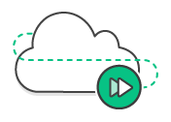
IBM Cloud DevOps Toolchain & Services
Benefits of DevOps
Rapid Delivery
Increase the frequency and pace of releases so you can innovate and improve your product faster. The quicker you can release new features and fix bugs, the faster you can respond to your customers’ needs and build competitive advantage.
Image Source: https://d1.awsstatic.com/Developer%20Marketing/DevOps/DevOps-What-is_delivery.ab8e4f4580bd50ef2536ac6726d8c599c0a321da.png
Notes:
Left (White Color space):
Title - Parent Topic
Subtitle - Subtopic 1
Body Text - Description in bullets
Right (Grey Color Space):
Body Text - Relevant image (with source)/code snippet
Put reference links in Speaker Notes
Reference:
https://www.tutorialspoint.com/internet_technologies/internet_overview.htm/

Slide 8
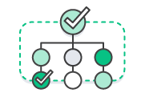
IBM Cloud DevOps Toolchain & Services
Benefits of DevOps
Reliability
Ensure the quality of application updates and infrastructure changes so you can reliably deliver at a more rapid pace while maintaining a positive experience for end users. Use practices like continuous integration and continuous delivery to test that each change is functional and safe.
Image Source: https://d1.awsstatic.com/Developer%20Marketing/DevOps/DevOps-What-is_reliability.d515ffafa232e62e769d9f2bbf78f4160f3239ad.png
Notes:
Left (White Color space):
Title - Parent Topic
Subtitle - Subtopic 1
Body Text - Description in bullets
Right (Grey Color Space):
Body Text - Relevant image (with source)/code snippet
Put reference links in Speaker Notes
Reference:
https://www.tutorialspoint.com/internet_technologies/internet_overview.htm/

Slide 9
IBM Cloud DevOps Toolchain & Services
Benefits of DevOps
Scale
Operate and manage your infrastructure and development processes at scale. Automation and consistency help you manage complex or changing systems efficiently and with reduced risk.
Image Source: https://d1.awsstatic.com/Developer%20Marketing/DevOps/DevOps-What-is_scale.87cace0a71f7578eb8aa79e61baa18e850b0e9ca.png
Notes:
Left (White Color space):
Title - Parent Topic
Subtitle - Subtopic 1
Body Text - Description in bullets
Right (Grey Color Space):
Body Text - Relevant image (with source)/code snippet
Put reference links in Speaker Notes
Reference:
https://www.tutorialspoint.com/internet_technologies/internet_overview.htm/

Slide 10

IBM Cloud DevOps Toolchain & Services
Benefits of DevOps
Improved Collaboration
Build more effective teams under a DevOps cultural model, which emphasizes values such as ownership and accountability. Developers and operations teams collaborate closely, share many responsibilities, and combine their workflows. This reduces inefficiencies and saves time
Image Source: https://d1.awsstatic.com/Developer%20Marketing/DevOps/DevOps-What-is_collaboration.135599d9c5b1f67bc1a40a7d4295cda99a30d7ff.png
Notes:
Left (White Color space):
Title - Parent Topic
Subtitle - Subtopic 1
Body Text - Description in bullets
Right (Grey Color Space):
Body Text - Relevant image (with source)/code snippet
Put reference links in Speaker Notes
Reference:
https://www.tutorialspoint.com/internet_technologies/internet_overview.htm/

Slide 11

IBM Cloud DevOps Toolchain & Services
Benefits of DevOps
Security
Move quickly while retaining control and preserving compliance. You can adopt a DevOps model without sacrificing security by using automated compliance policies, fine-grained controls, and configuration management techniques.
Image Source: https://d1.awsstatic.com/Developer%20Marketing/DevOps/DevOps-What-is_security.4246af1c9c37ce52cca4fac51f786a524836e04d.png
Notes:
Left (White Color space):
Title - Parent Topic
Subtitle - Subtopic 1
Body Text - Description in bullets
Right (Grey Color Space):
Body Text - Relevant image (with source)/code snippet
Put reference links in Speaker Notes
Reference:
https://www.tutorialspoint.com/internet_technologies/internet_overview.htm/

Slide 12
IBM Cloud DevOps Toolchain & Services
DevOps Services
IBM Cloud Continuous Delivery
IBM Cloud App Configuration
IBM Cloud Schematics
IBM Key Protect
IBM Cloud Secrets Manager
IBM Kubernetes Service
IBM Cloud Satellite
IBM Cloud Code Engine
IBM Cloud Monitoring
IBM Cloud Security and Compliance Center
IBM Cloud Activity Tracker
Image Source: https://d1.awsstatic.com/Developer%20Marketing/DevOps/DevOps-What-is_security.4246af1c9c37ce52cca4fac51f786a524836e04d.png
Notes:
Left (White Color space):
Title - Parent Topic
Subtitle - Subtopic 1
Body Text - Description in bullets
Right (Grey Color Space):
Body Text - Relevant image (with source)/code snippet
Put reference links in Speaker Notes
Reference:
https://www.tutorialspoint.com/internet_technologies/internet_overview.htm/

Slide 13
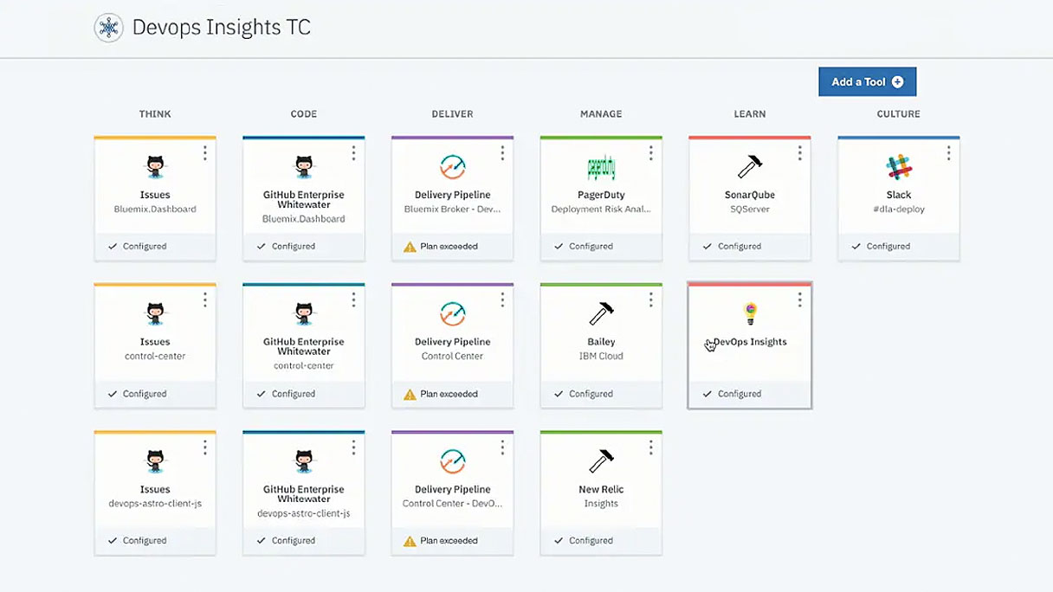
Notes:
Left (White Color space):
Title - Parent Topic
Subtitle - Subtopic 1
Body Text - Description in bullets
Right (Grey Color Space):
Body Text - Relevant image (with source)/code snippet
Put reference links in Speaker Notes
Reference:
https://www.tutorialspoint.com/internet_technologies/internet_overview.htm/

Slide 14
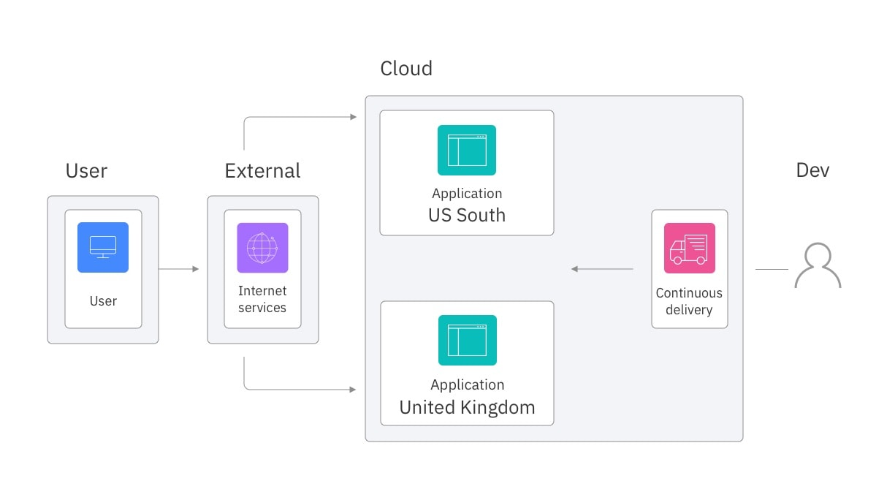
IBM Cloud DevOps Toolchain & Services
Continuous Delivery
IBM Cloud® Continuous Delivery, which includes open toolchains that automate the building and deployment of applications. You can get started by creating a simple deployment toolchain that supports development, deployment, and operations tasks.
Image Source: https://1.cms.s81c.com/sites/default/files/2021-12-23/cloud-foundry-use-cases-deploy-across-regions.jpg
Notes:
Left (White Color space):
Title - Parent Topic
Subtitle - Subtopic 1
Body Text - Description in bullets
Right (Grey Color Space):
Body Text - Relevant image (with source)/code snippet
Put reference links in Speaker Notes
Reference:
https://www.tutorialspoint.com/internet_technologies/internet_overview.htm/

Slide 15
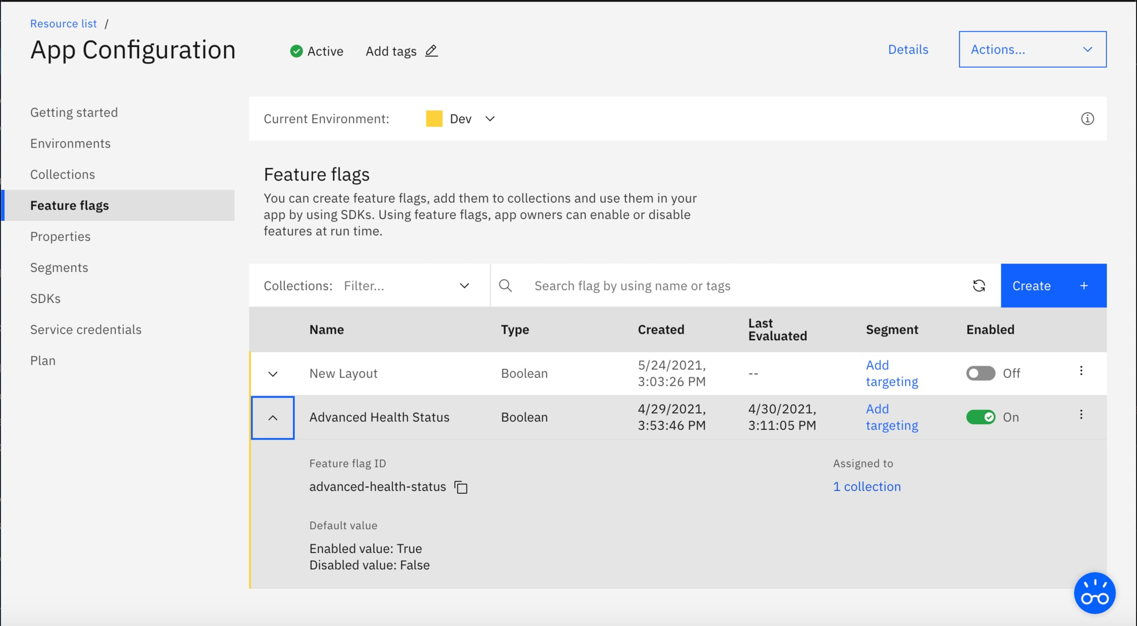
IBM Cloud DevOps Toolchain & Services
App Configuration
Centralize feature management and configuration.
Image Source: https://1.cms.s81c.com/sites/default/files/2021-05-25/appcon.png
Notes:
Left (White Color space):
Title - Parent Topic
Subtitle - Subtopic 1
Body Text - Description in bullets
Right (Grey Color Space):
Body Text - Relevant image (with source)/code snippet
Put reference links in Speaker Notes
Reference:
https://www.tutorialspoint.com/internet_technologies/internet_overview.htm/

Slide 16
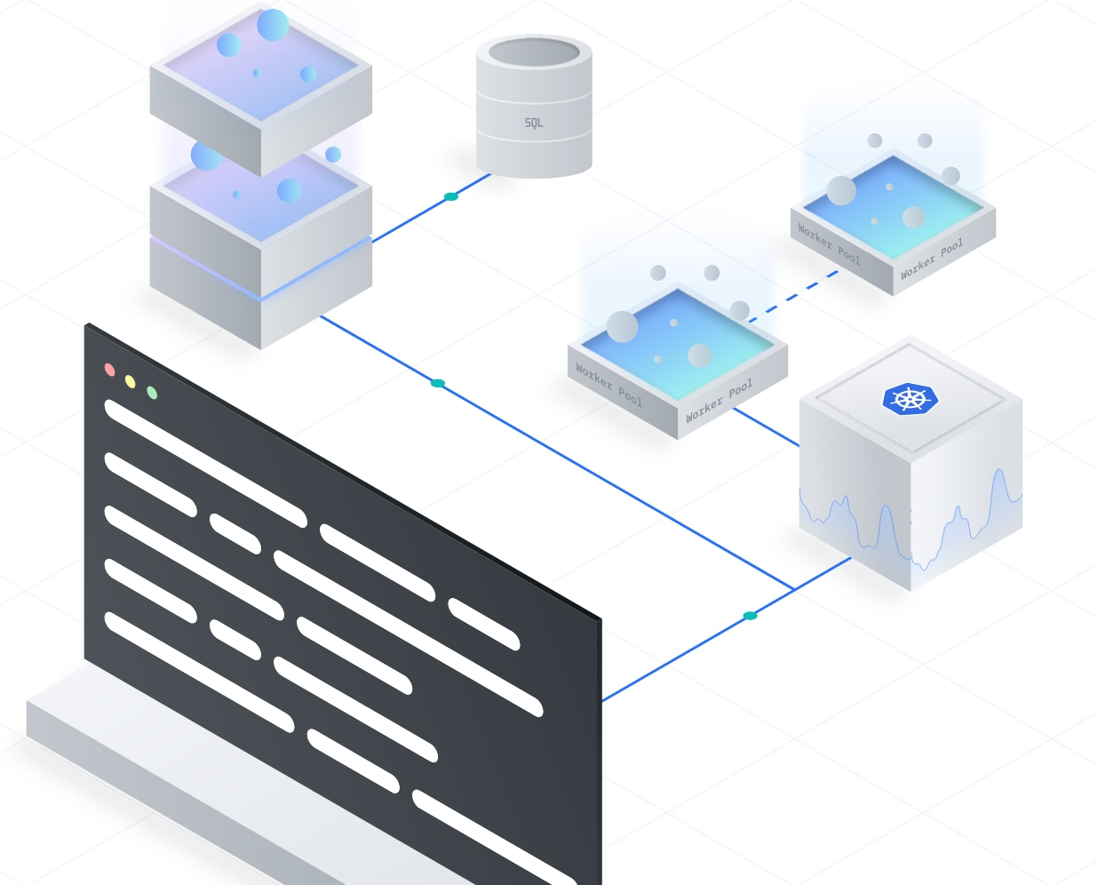
IBM Cloud DevOps Toolchain & Services
IBM Cloud Schematics
Configure and automate management of IBM Cloud resources.
Image Source: https://1.cms.s81c.com/sites/default/files/2021-09/Screen%20Shot%202021-09-13%20at%203.17.29%20PM.png
Notes:
Left (White Color space):
Title - Parent Topic
Subtitle - Subtopic 1
Body Text - Description in bullets
Right (Grey Color Space):
Body Text - Relevant image (with source)/code snippet
Put reference links in Speaker Notes
Reference:
https://www.tutorialspoint.com/internet_technologies/internet_overview.htm/

Slide 17
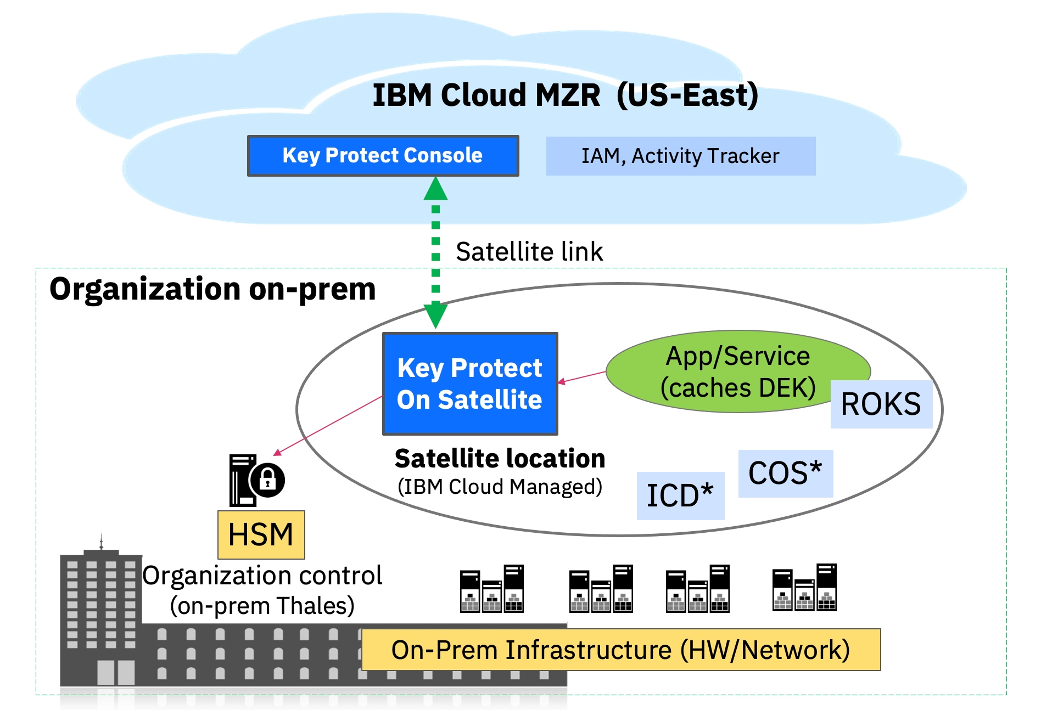
IBM Cloud DevOps Toolchain & Services
IBM Key Protect
Get visibility and control of entire key lifecycle.
Image Source: https://1.cms.s81c.com/sites/default/files/2021-12-16/Screen%20Shot%202021-12-16%20at%2012.42.03%20PM.png
Notes:
Left (White Color space):
Title - Parent Topic
Subtitle - Subtopic 1
Body Text - Description in bullets
Right (Grey Color Space):
Body Text - Relevant image (with source)/code snippet
Put reference links in Speaker Notes
Reference:
https://www.tutorialspoint.com/internet_technologies/internet_overview.htm/

Slide 18
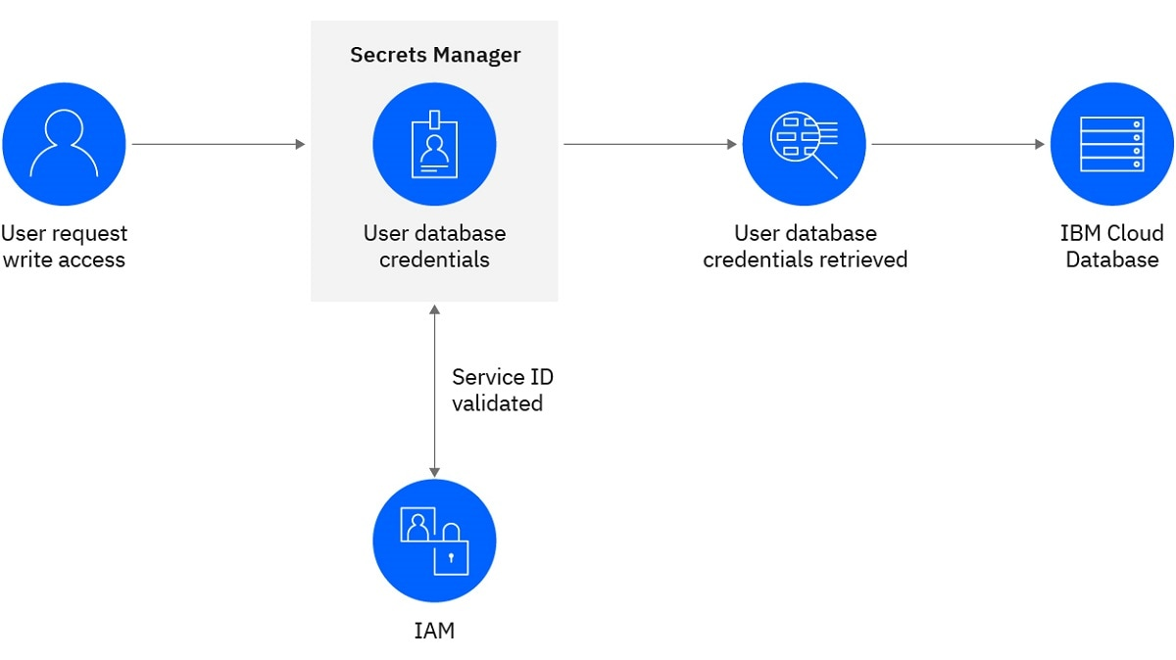
IBM Cloud DevOps Toolchain & Services
IBM Cloud Secrets Manager
Centrally manage secrets used in your apps and services.
Image Source: https://1.cms.s81c.com/sites/default/files/2020-10/Secrets%20Manager_624X351%403x-100.jpg
Notes:
Left (White Color space):
Title - Parent Topic
Subtitle - Subtopic 1
Body Text - Description in bullets
Right (Grey Color Space):
Body Text - Relevant image (with source)/code snippet
Put reference links in Speaker Notes
Reference:
https://www.tutorialspoint.com/internet_technologies/internet_overview.htm/

Slide 19
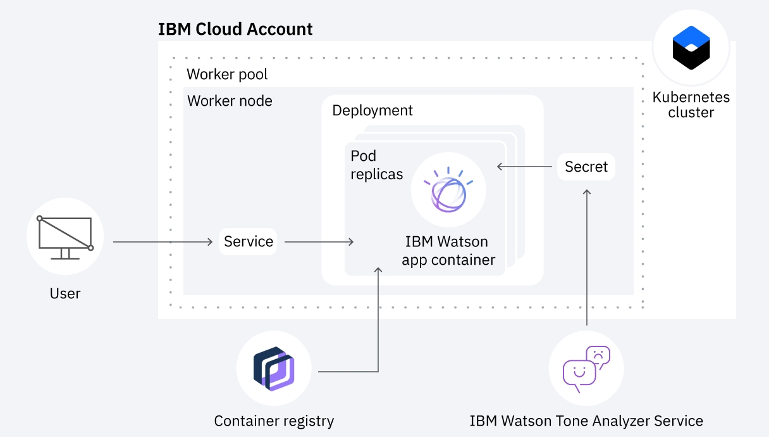
IBM Cloud DevOps Toolchain & Services
IBM Kubernetes Service
Deploy and operate a Kubernetes cluster on IBM Cloud.
Image Source: https://1.cms.s81c.com/sites/default/files/2020-11-25/create-clusters-image.png
Notes:
Left (White Color space):
Title - Parent Topic
Subtitle - Subtopic 1
Body Text - Description in bullets
Right (Grey Color Space):
Body Text - Relevant image (with source)/code snippet
Put reference links in Speaker Notes
Reference:
https://www.tutorialspoint.com/internet_technologies/internet_overview.htm/

Slide 20
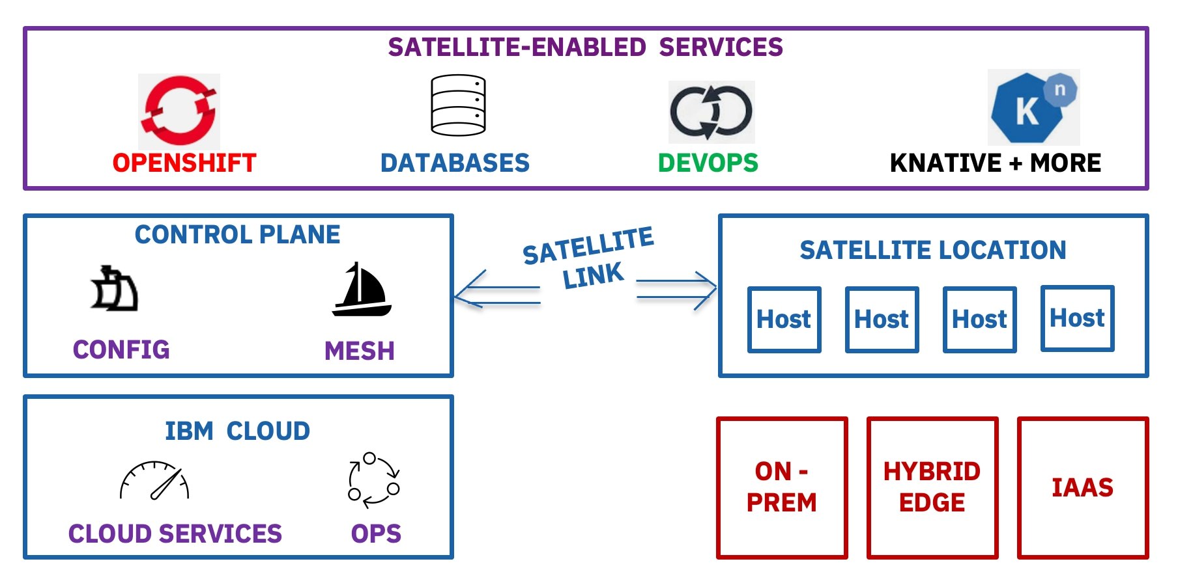
IBM Cloud DevOps Toolchain & Services
IBM Cloud Satellite
Run IBM Cloud services on your infrastructure with consistency.
Image Source: https://1.cms.s81c.com/sites/default/files/2021-12-20/Screen%20Shot%202021-12-20%20at%208.40.52%20AM.png
Notes:
Left (White Color space):
Title - Parent Topic
Subtitle - Subtopic 1
Body Text - Description in bullets
Right (Grey Color Space):
Body Text - Relevant image (with source)/code snippet
Put reference links in Speaker Notes
Reference:
https://www.tutorialspoint.com/internet_technologies/internet_overview.htm/

Slide 21
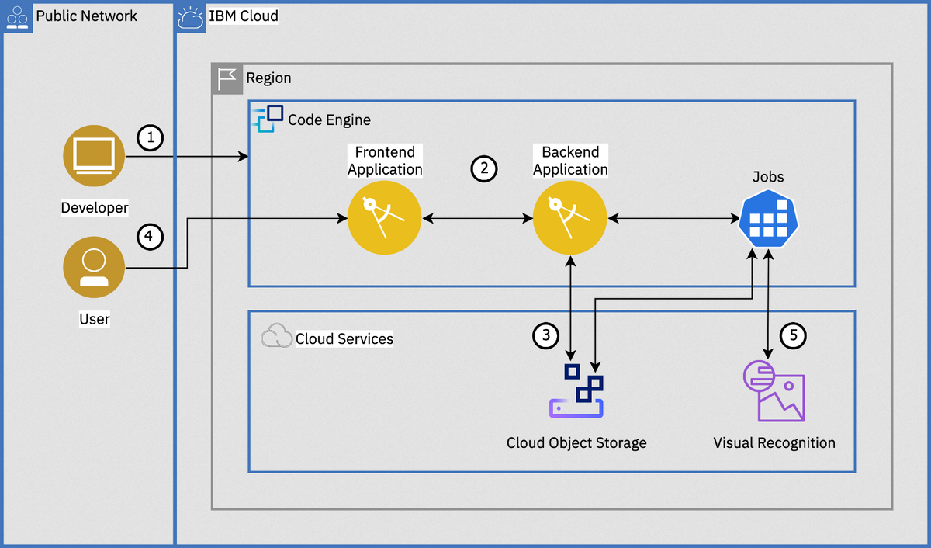
IBM Cloud DevOps Toolchain & Services
IBM Cloud Code Engine
Run your application, batch jobs or container on a managed serverless platform.
Image Source: https://imgopt.infoq.com/fit-in/1200x2400/filters:quality(80)/filters:no_upscale()/news/2020/10/ibm-cloud-code-engine/en/resources/1ibm-1601889808473.png
Notes:
Left (White Color space):
Title - Parent Topic
Subtitle - Subtopic 1
Body Text - Description in bullets
Right (Grey Color Space):
Body Text - Relevant image (with source)/code snippet
Put reference links in Speaker Notes
Reference:
https://www.tutorialspoint.com/internet_technologies/internet_overview.htm/

Slide 22

IBM Cloud DevOps Toolchain & Services
IBM Cloud Monitoring
Get in-depth visibility into infrastructure and app performance.
Image Source: https://1.cms.s81c.com/sites/default/files/2021-04/Sysdig-laptop-low-res_0.png
Notes:
Left (White Color space):
Title - Parent Topic
Subtitle - Subtopic 1
Body Text - Description in bullets
Right (Grey Color Space):
Body Text - Relevant image (with source)/code snippet
Put reference links in Speaker Notes
Reference:
https://www.tutorialspoint.com/internet_technologies/internet_overview.htm/

Slide 23
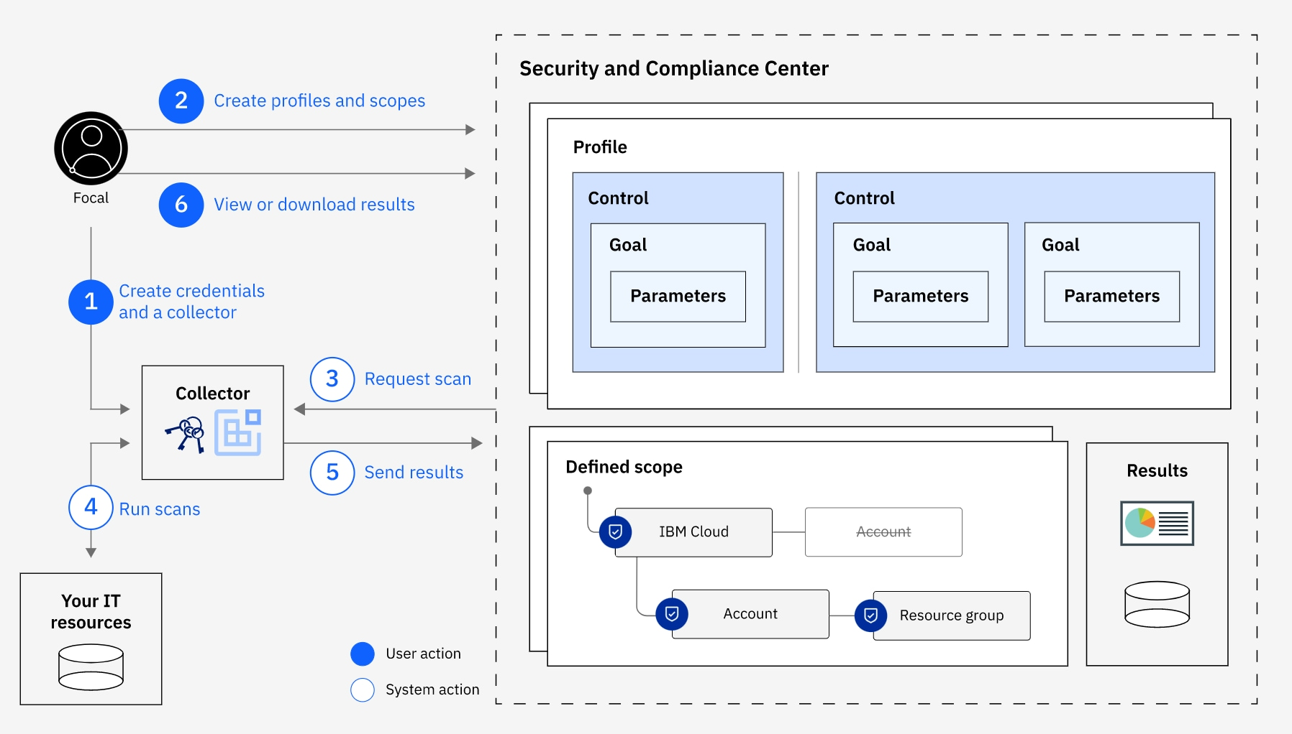
IBM Cloud DevOps Toolchain & Services
IBM Cloud Security and Compliance Center
Govern cloud resource configurations and centrally manage your compliance with organization and regulatory guidelines.
Image Source: https://1.cms.s81c.com/sites/default/files/2020-09-01/Screen%20Shot%202020-09-01%20at%209.30.07%20AM.png
Notes:
Left (White Color space):
Title - Parent Topic
Subtitle - Subtopic 1
Body Text - Description in bullets
Right (Grey Color Space):
Body Text - Relevant image (with source)/code snippet
Put reference links in Speaker Notes
Reference:
https://www.tutorialspoint.com/internet_technologies/internet_overview.htm/

Slide 24
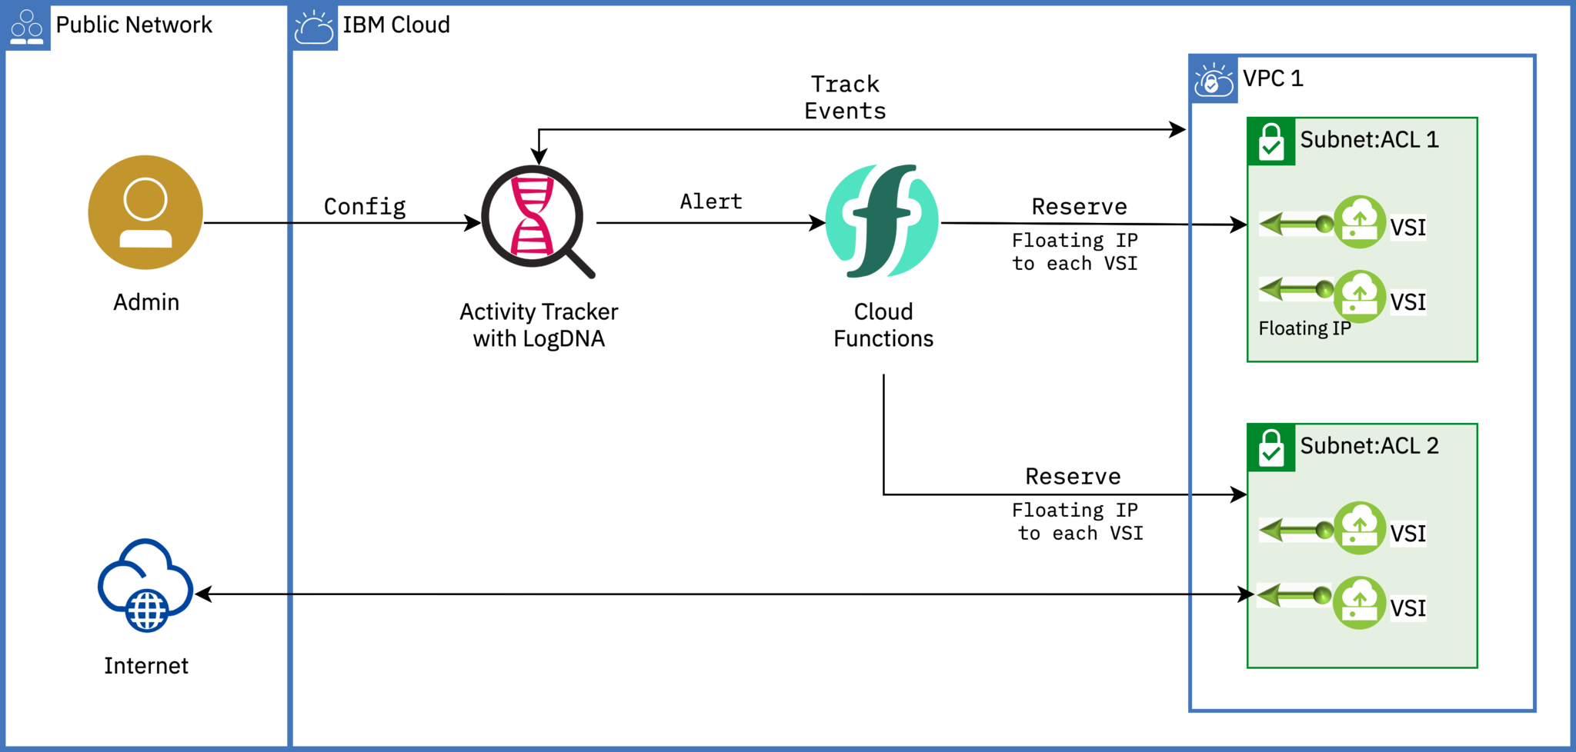
IBM Cloud DevOps Toolchain & Services
IBM Cloud Activity Tracker
Manage compliance controls within the IBM Cloud platform.
Image Source: https://1.cms.s81c.com/sites/default/files/2020-07-31/vv1.png
Notes:
Left (White Color space):
Title - Parent Topic
Subtitle - Subtopic 1
Body Text - Description in bullets
Right (Grey Color Space):
Body Text - Relevant image (with source)/code snippet
Put reference links in Speaker Notes
Reference:
https://www.tutorialspoint.com/internet_technologies/internet_overview.htm/

